Slide 1


DELIVERABLES
Team F
Raphael Gastaldo – Hadi Daccache – Alexandre Johannel – Adrian Rubem

Slide 2

Focus 2 Issue
© COmind

Slide 3
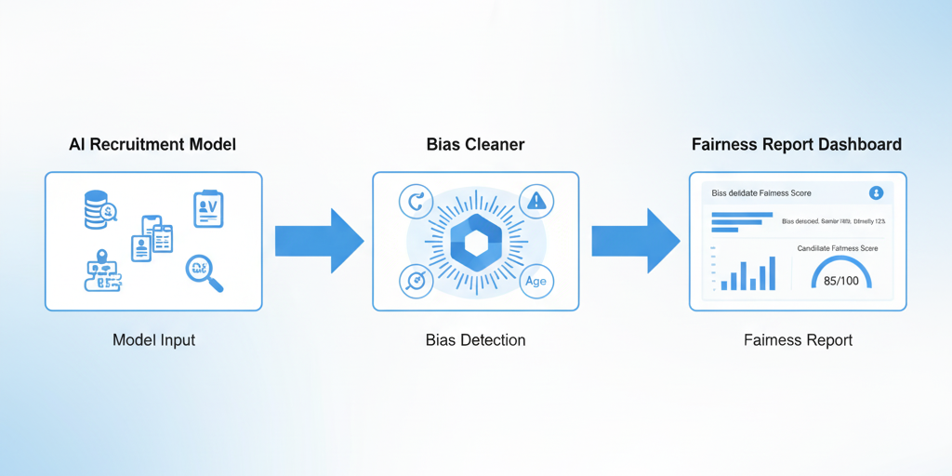
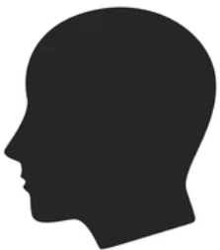
Bias Cleaner — Mockup of the Proposed Detection Technology
Early adopter
Mockup of the Proposed Detection Technology
Questions asked to early adopters :
Does this type of analysis interface seem useful and easy to understand for AI or HR teams?
Based on the mockup above, would these results help you make fairer recruitment decisions?
© COmind

Slide 4

CONTACT
First Name : Claire Name : Lefèvre
Education : Master’s Degree in Human Resources & Data Analytics — Université Paris Dauphine
Current position : Paris, France
Organization : Tech & Digital Consulting Company (≈ 800 employees)
Claire has been working in recruitment for over 10 years. Her company has recently integrated AI-driven tools to preselect candidates and predict “job fit” scores. While these systems have improved efficiency, Claire has noticed unexplained discrepancies in candidate shortlists — some qualified profiles are being filtered out without clear reasons.
She suspects that biases in data or algorithms (gender, age, or school background) could influence AI decisions, but she lacks the technical skills and tools to verify or measure this.
© COmind

Slide 5
BiasCleaner user problem
What ? AI recruitment systems often make automated decisions (shortlisting, scoring, ranking) based on biased data or hidden correlations.
Who ? HR data managers, recruiters, and data scientists who rely on AI tools to screen candidates.
Where ? In medium and large organizations using data-driven recruitment platforms or predictive hiring models.
When ? During the candidate preselection and evaluation phases, especially when algorithms are used to analyze CVs or interview data.
How ? Because the AI model reproduces patterns from historical data, it may unconsciously favor certain profiles (e.g., gender, age, education background). Users currently lack visibility into how these biases appear or affect fairness metrics.
Why ? To ensure fair, transparent, and explainable recruitment decisions, compliant with ethical standards and diversity goals.
The Issue : How can we detect, measure, and visualize algorithmic bias within recruitment AI systems, so that HR and data teams can identify unfair outcomes and improve decision transparency?
© COmind

Slide 6
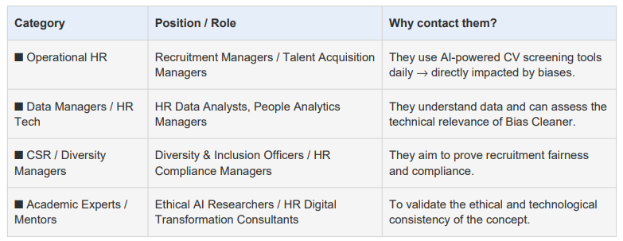
BiasCleaner user problem
- Recruitment processes increasingly rely on AI tools — yet these systems often reproduce human bias. BiasCleaner targets the key stakeholders most exposed to this risk.
- These personas represent the first users to test and validate BiasCleaner’s impact on fairness and transparency.
© COmind

Slide 7


Collaborative mindset
Erik EMOTTE
06 38 11 85 81
erik.emotte@comind.fr
Frédéric REMAUD
06 20 77 36 06
frederic.remaud@comind.fr
© Copyright – All rights reserved
Ce document est la propriété exclusive de Frédéric Remaud domicilié au 27, rue du Vieux Faubourg 59800 Lille de Erik Emotte domicilié au 47, boulevard de Montalembert, 59493 Villeneuve d’Ascq.
Il ne peut être communiqué à des tiers sans leur autorisation. Fait à Villeneuve d'Ascq le 11/11/2021.
Notes:
Merci pour votre attention.
Je suis à l’écoute de vos questions.

